Slide 1
Advance Excel
-By Chitra

Slide 2
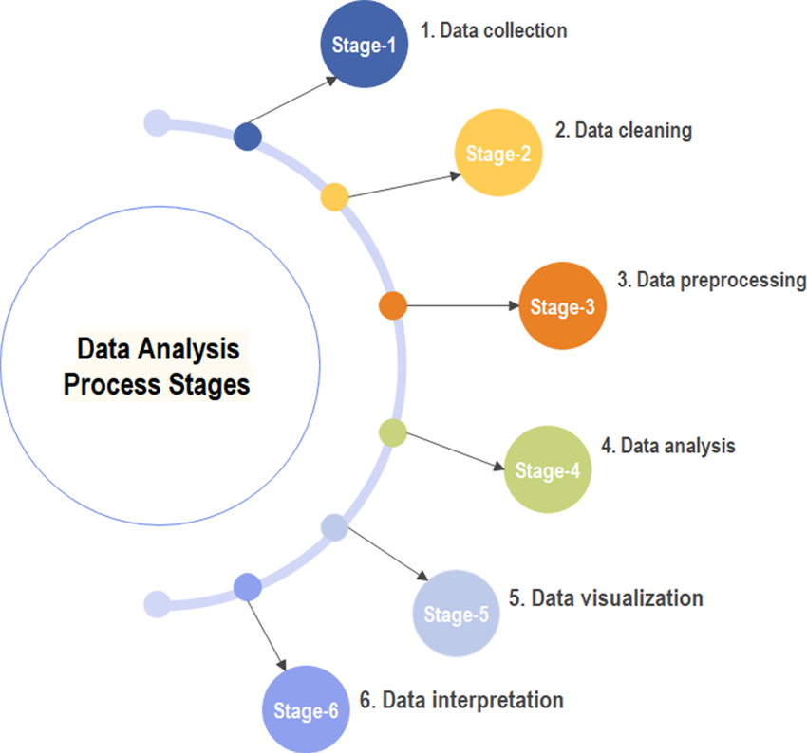
Contents
Objective
Sample Questions
Data content
Data Cleaning
Data Processing
Data Analysis
Interactive Dashboard
Insights

Slide 3
Objective
Vrinda Store wants to create an annual sales report for 2022. So that, Vrinda can understand their customers and grow more sales in 2023
Dataset : Vrinda Stores Data Analyst
Excel Dataset Download (direct):
https://docs.google.com/spreadsheets/d/1ekrPCv2ZcBZ-cySADo1YGOfcRY9OA4GP/edit?usp=sharing&ouid=102417869513104761003&rtpof=true&sd=true

Slide 4

Sample Questions
Compare the sales and orders using single chart.
Which month got the highest sales and orders?
Who purchased more-men or women in 2022?
What are different order status in 2022?
List top 10 states contributing to the sales?
Relation between age and gender based on number of orders.
Which channel is contributing to maximum sales?
Highest selling category,etc.

Slide 5
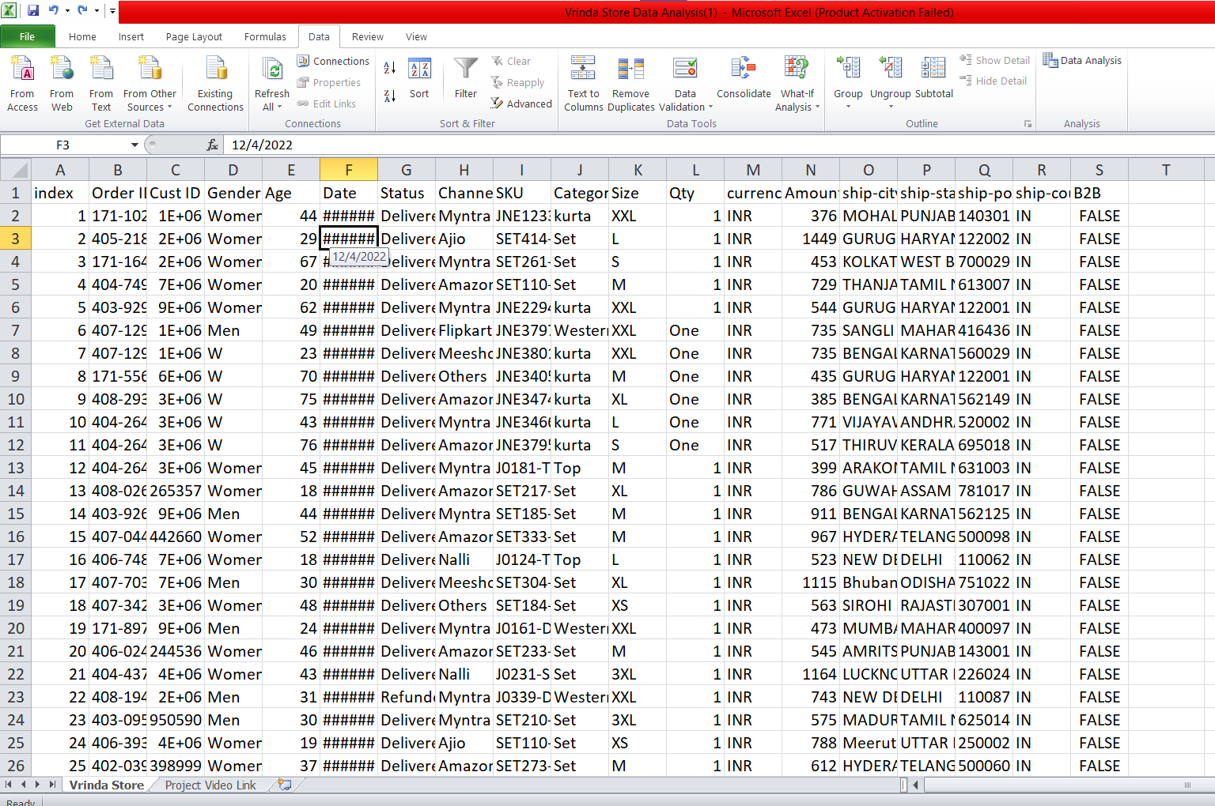
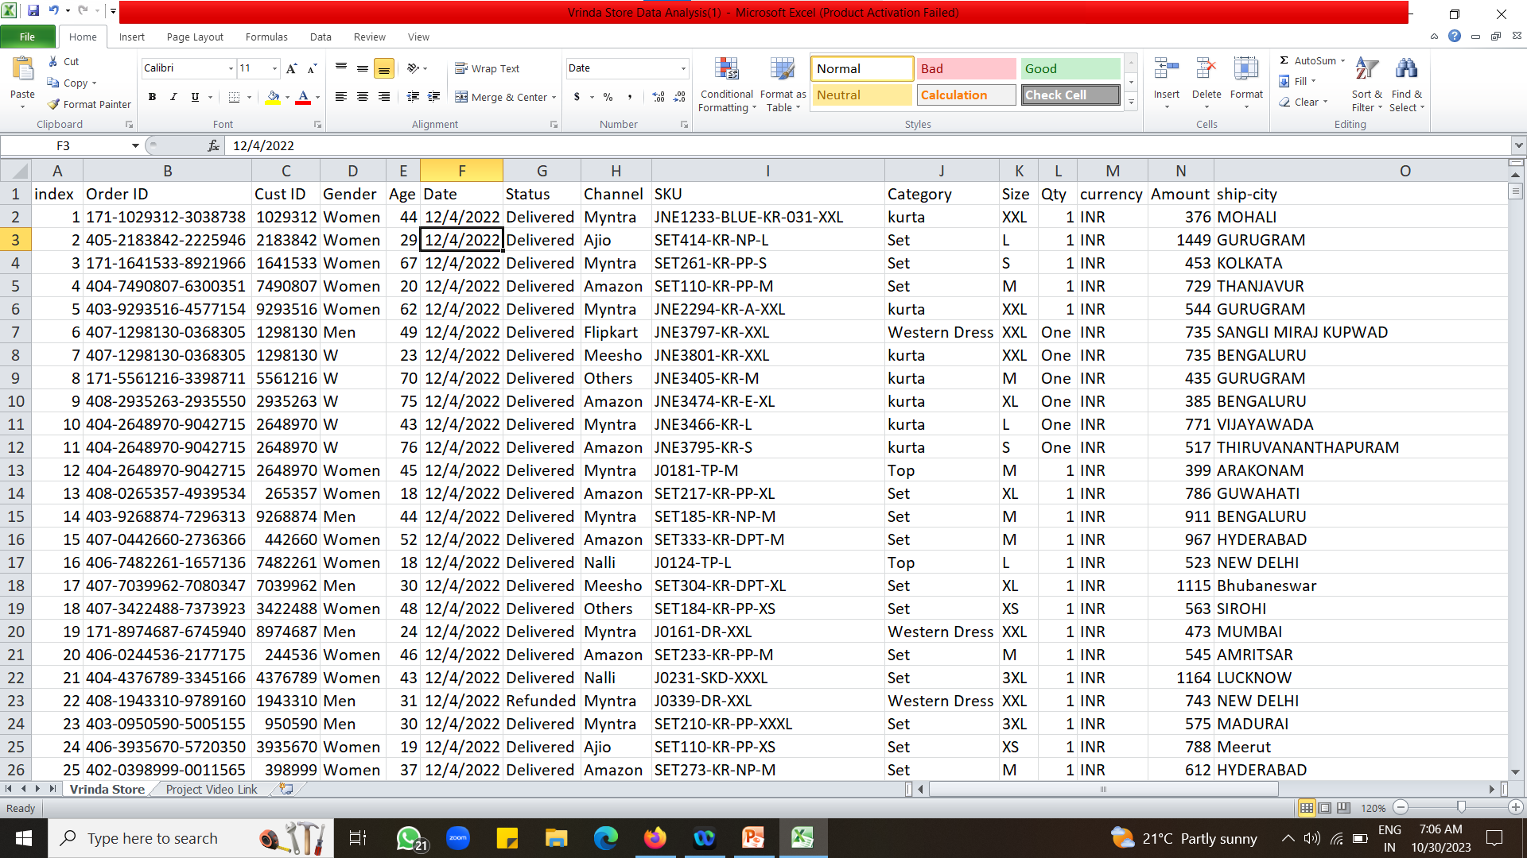
Data contents

Slide 6
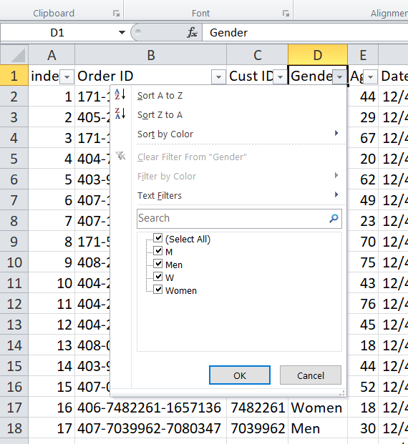
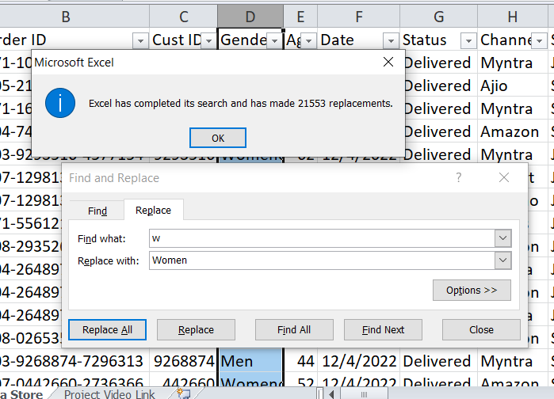
Data Cleaning
Column 1- Index should be always unique value.
Column 2 – Order ID the values should unique and non repeated means no duplicate values and have to check null values means blank cell.
Column 3 – Cust ID the values should be numerical and check null values .
Column 4 – Gender the values are showing different some where is Male and somewhere is similarly for Women and W. Replace it in one format (select the column press Ctrl + H for replace)
Note : Check Null values in all column it create difficulties to analysis either you can remove it or replace it. Check duplicate values in each column if its ok then fine or replace it. For easy to check put filter on the data all the unique value shows directly Ctrl + Shift + L Shortcut key for filter.
Clean all the columns by using same process.

Slide 7
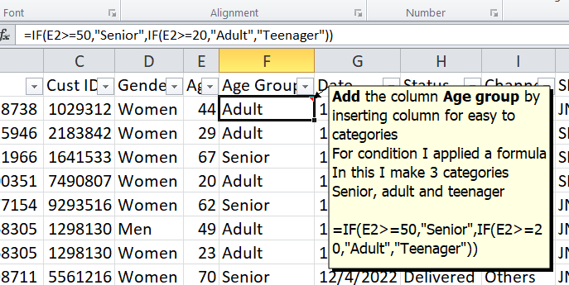
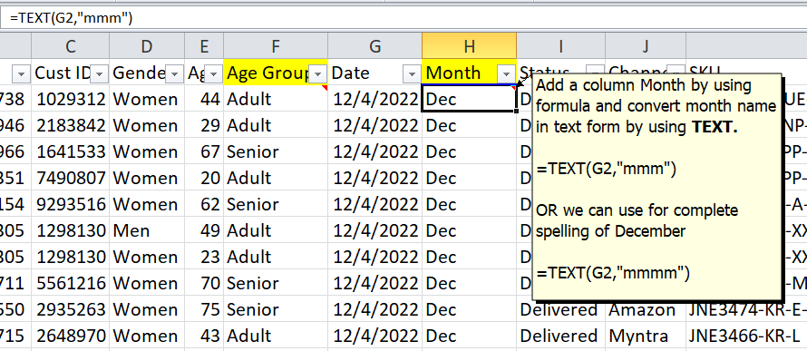
Data Processing
For compare sales & orders we can categories product items according to age groups.
For month wise the highest sales and orders comparison again we create a column and by applying formula we separately enter the month that can be easy to analysis.

Slide 8
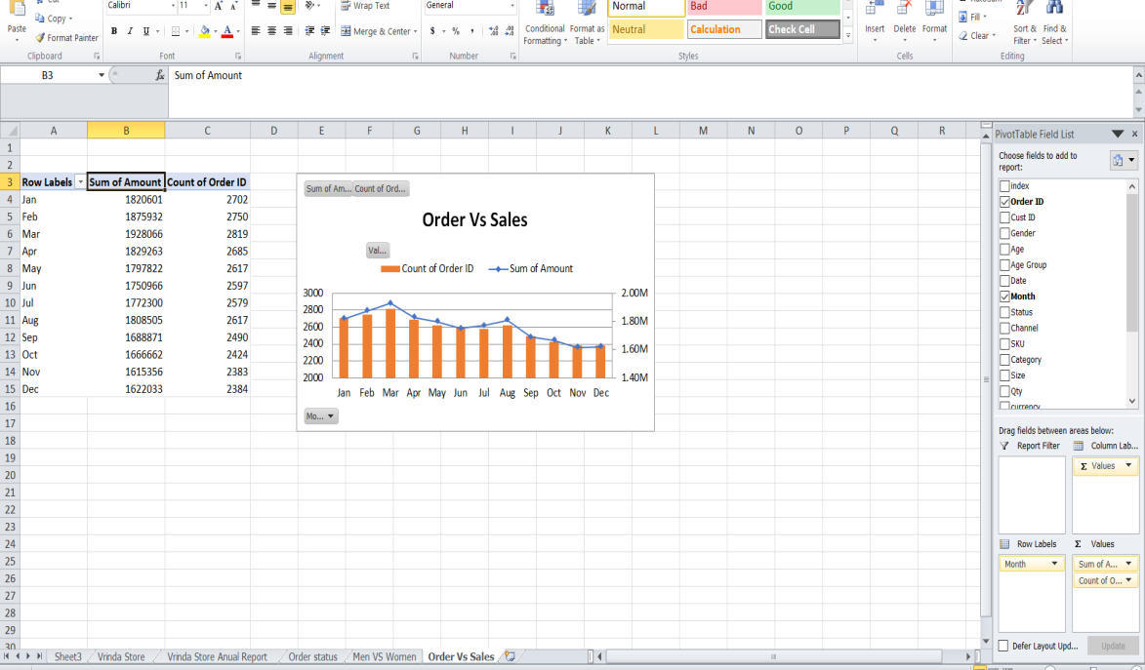
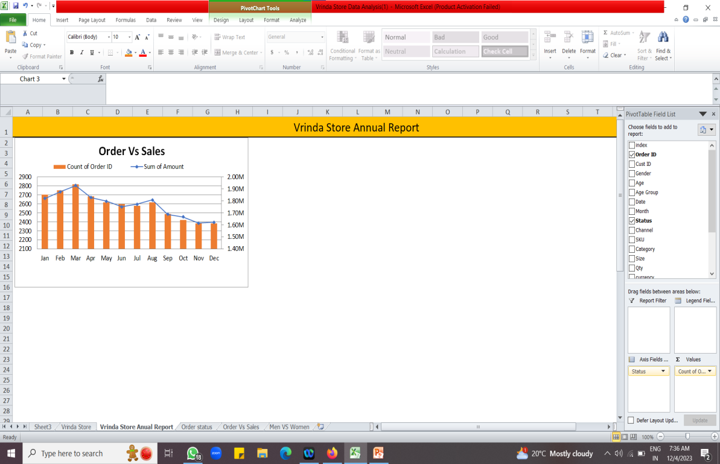
Data Analysis
Steps to create Pivot chart :
Select all the data and go to insert then there is the option of Pivot Chart.
According to the proper view of the data in the table we can choose the charts.
To create a chart we have to drag and drop the column names to the value and column , row section.
Steps to create a dashboard:
First we have to create new tab then as we don’t want to gridlines we want plan page, go to the View the gridlines option is there we have to off that option.
Copy that chart you previously make and paste in the blank space.
This is our two sample question.
1) Compare the sales and orders using single chart.
2) Which month got the highest sales and orders?
Which is solve in one chart.

Slide 9
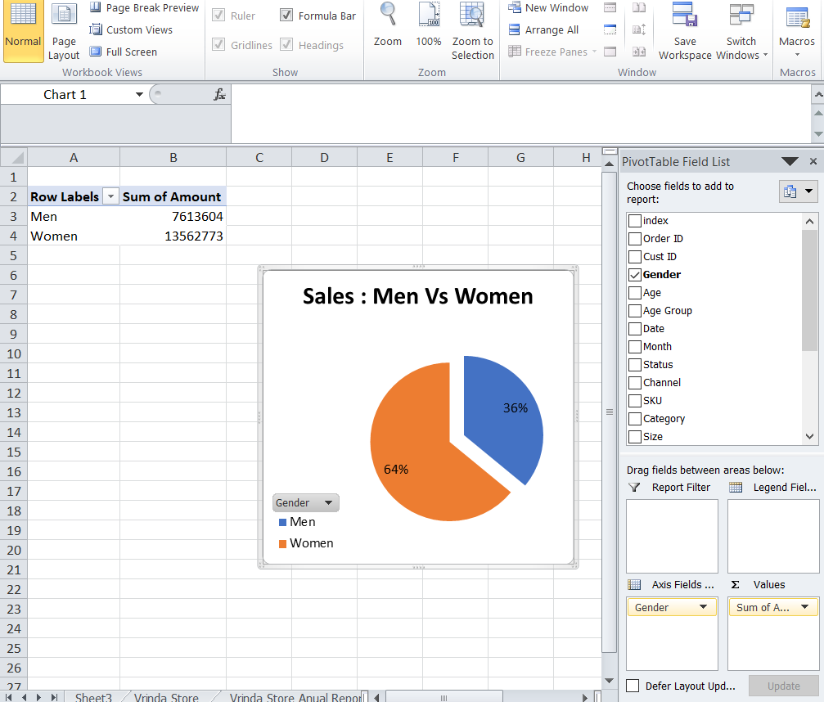
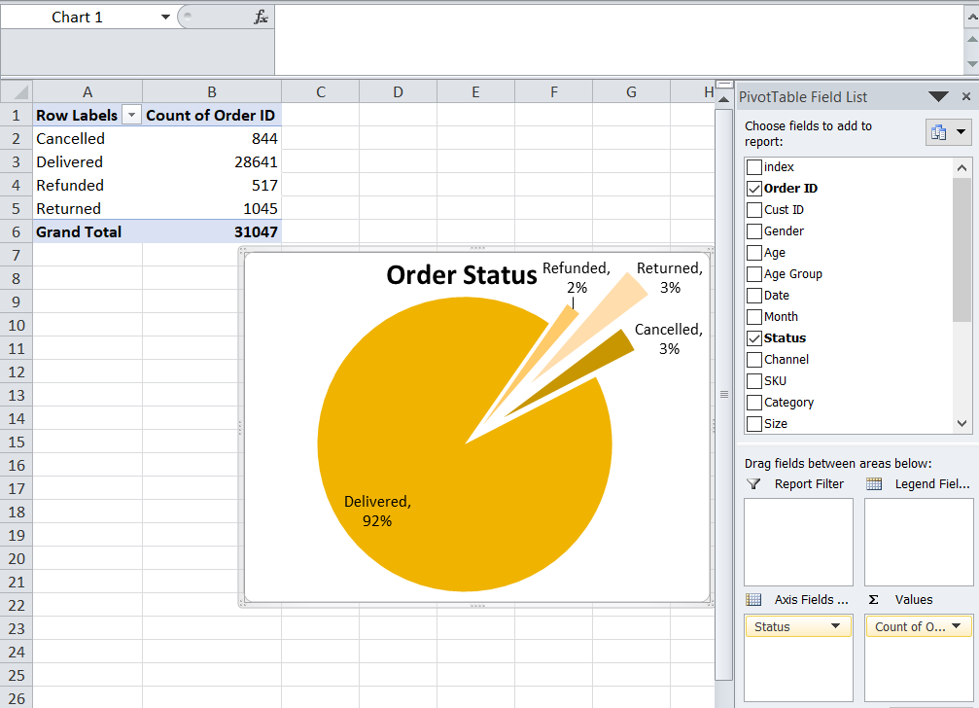
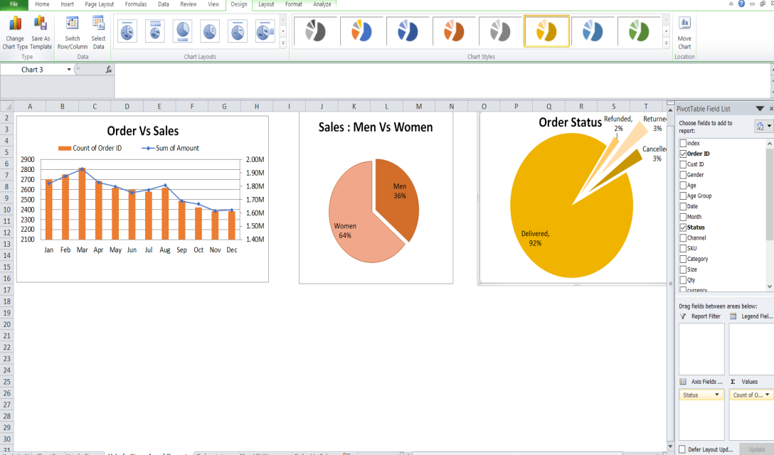
Who purchased more-men or women in 2022?
By creating the pie chart we can compare the who purchased the products from the store
What are different order status in 2022?
By creating pie charts and edit the slice by dragging outsides its looks good for the clear data visualizations for more proper view by edit option I select the legends option and as I required percentage for comparison, I select the value option make the percentage option.

Slide 10
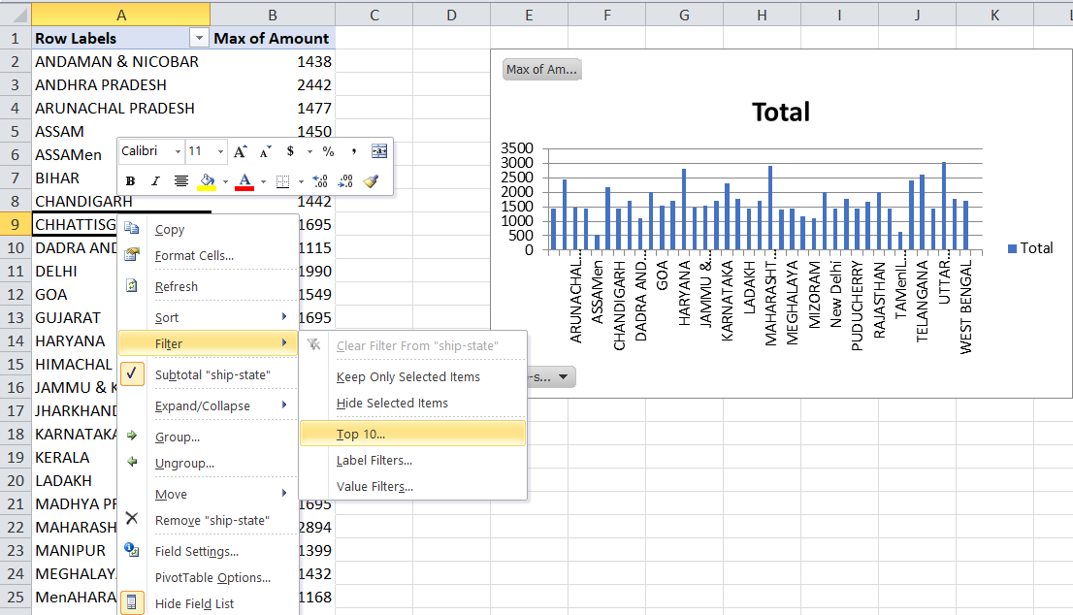
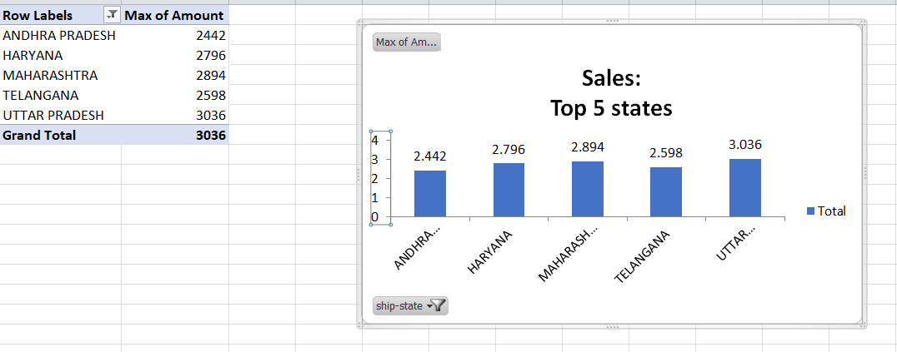
List top 10 states contributing to the sales?
Click right botton and select filter after creating pivot table, select top 10 or you can enter 5 if you want top 5

Slide 11
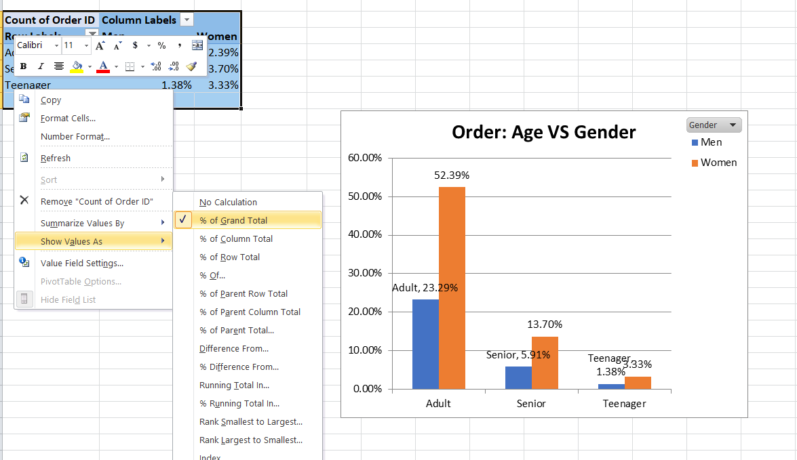
Relation between age and gender based on number of orders.
Click right button go to show values as click on % grand total by percent

Slide 12
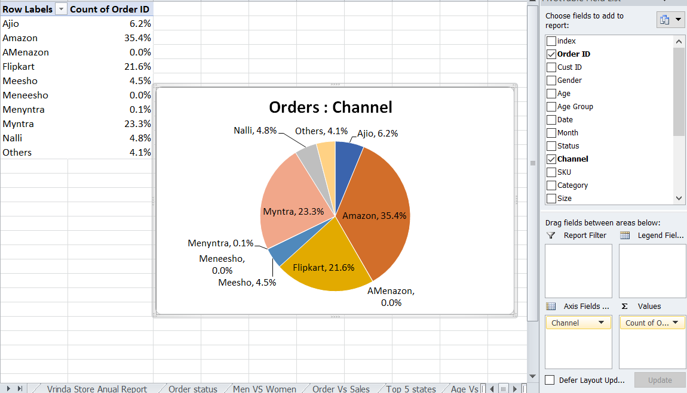
Which channel is contributing to maximum sales?

Slide 13
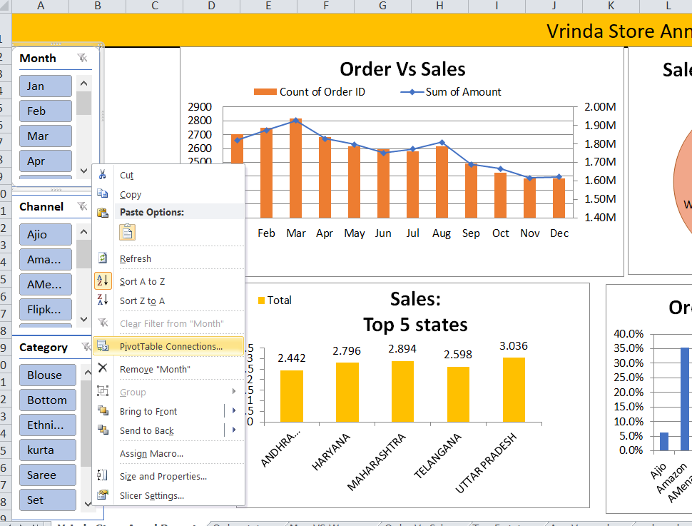
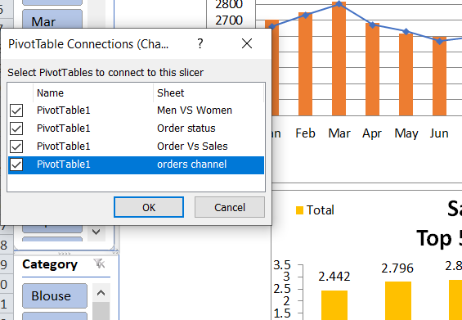
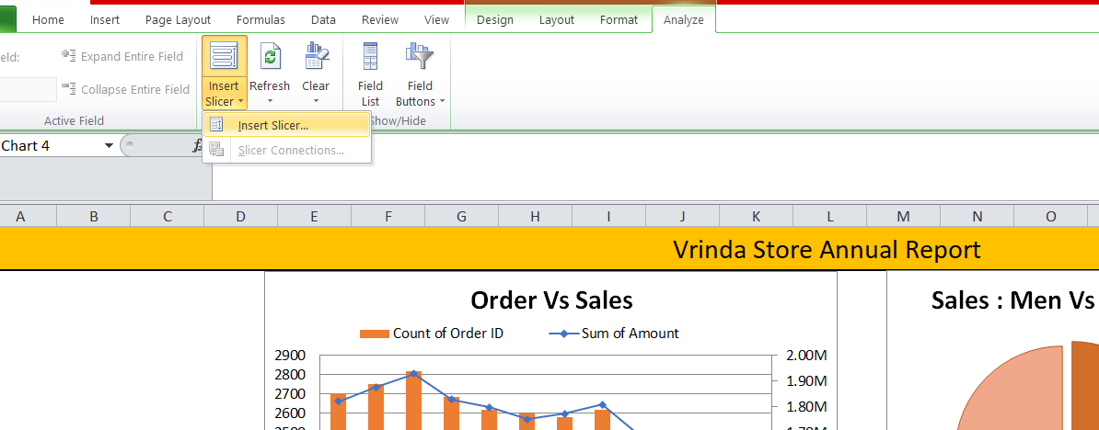
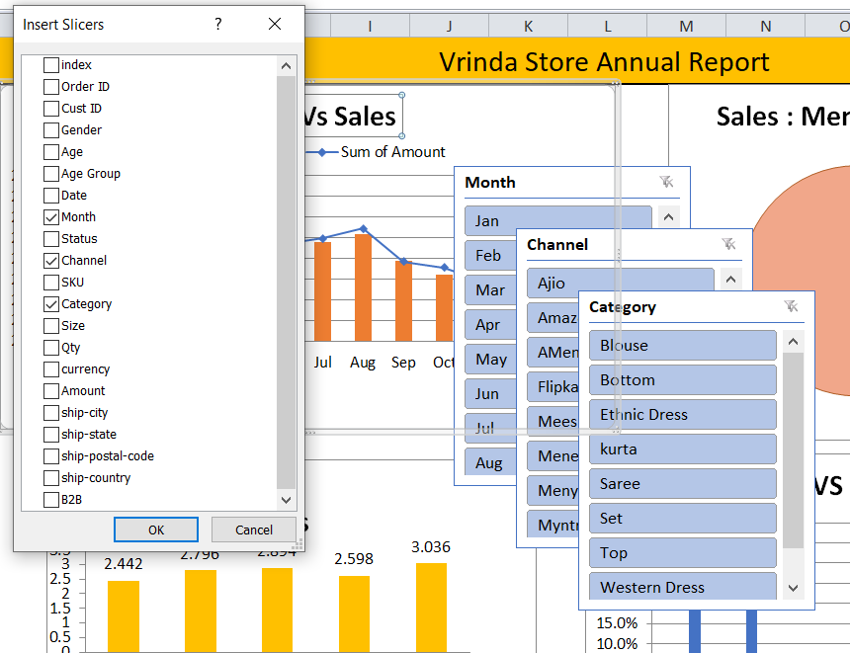
Highest selling category,etc.
To see the highest selling we add a slicers according to the month, category and channel we can campare the highest sells.
Connect all the pivot table by right click you got that pivot connection option then you can compare according to putting filter by simple selecting option like you want to see January month data simply select and you can compare it.
Want to remove option in corner the filter option is there you can off that option.

Slide 14
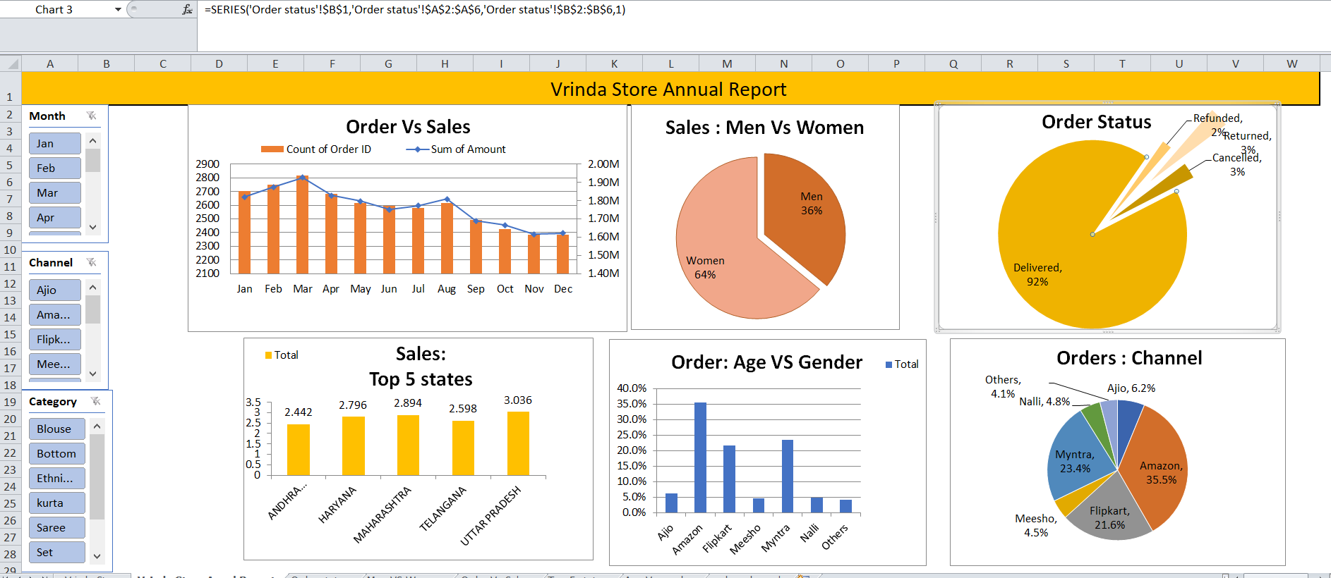
Dashboard

Slide 15
Insights
Women are more likely to buy compared to men(-65%)
Maharashtra, Karnataka and Uttar Pradesh and the top 3 states(-35%)
Adult age group (30-49yrs) in max contributing(-50%)
Amazon, Flipkart and Myntra channels are max contributing(-80%)
Final conclusion to improve Vrinda Store Sales:
Target women customers of age group (30-49 yrs) living in Maharashtra, Karnataka and Uttar Pradesh by showing ads/ offers/ coupons available on Amazon, Flipkart and Myntra.

